Slide 1
UNIT I
INTRODUCTION
SEM VII : CSS
Notes:
Lecture slides by Lawrie Brown for “Cryptography and Network Security”, 5/e, by William Stallings, briefly reviewing the text outline from Ch 0, and then presenting the content from Chapter 1 – “Introduction”.

Slide 2
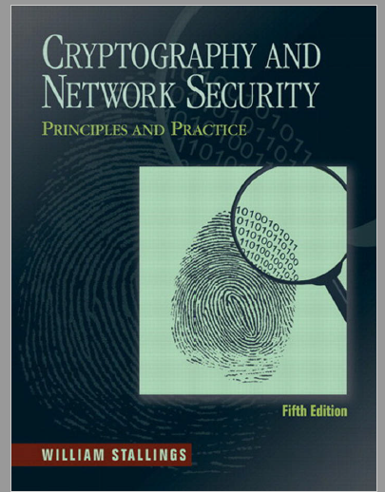
Chapter 1
OVERVIEW
1.1 Computer Security Concepts
A Definition of Computer Security
Examples
The Challenges of Computer Security
1.2 The OSI Security Architecture
1.3 Security Attacks
Passive Attacks
Active Attacks
1.4 Security Services
Authentication
Access Control
Data Confidentiality
Data Integrity
Nonrepudiation
Availability Service
1.5 Security Mechanisms

Slide 3
Computer Security
the protection afforded to an automated information system in order to attain the applicable objectives of preserving the integrity, availability and confidentiality of information system resources (includes hardware, software, firmware, information/data, and telecommunications)
Notes:
The NIST Computer Security Handbook [NIST95] defines the term computer security as shown on this slide. This definition introduces three key objectives that are at the heart of computer security as we see on the next slide.

Slide 4

Key Security Concepts
Notes:
These three concepts form what is often referred to as the CIA triad (Figure 1.1). The three concepts embody the fundamental security objectives for both data and for information and computing services. FIPS PUB 199 provides a useful characterization of these three objectives in terms of requirements and the definition of a loss of security in each category:
• Confidentiality (covers both data confidentiality and privacy): preserving authorized restrictions on information access and disclosure, including means for protecting personal privacy and proprietary information. A loss of confidentiality is the unauthorized disclosure of information.
• Integrity (covers both data and system integrity): Guarding against improper information modification or destruction, and includes ensuring information non-repudiation and authenticity. A loss of integrity is the unauthorized modification or destruction of information.
• Availability: Ensuring timely and reliable access to and use of information. A loss of availability is the disruption of access to or use of information or an information system.
Although the use of the CIA triad to define security objectives is well established, some in the security field feel that additional concepts are needed to present a complete picture. Two of the most commonly mentioned are:
• Authenticity: The property of being genuine and being able to be verified and trusted; confidence in the validity of a transmission, a message, or message originator.
• Accountability: The security goal that generates the requirement for actions of an entity to be traced uniquely to that entity.

Slide 5
This definition introduces three key objectives that are at the heart of
computer security:
• Confidentiality: This term covers two related concepts:
Data1 confidentiality: Assures that private or confidential information is
not made available or disclosed to unauthorized individuals.
Privacy: Assures that individuals control or influence what information
related to them may be collected and stored and by whom and to whom
that information may be disclosed.
• Integrity: This term covers two related concepts:
Data integrity: Assures that information and programs are changed only in
a specified and authorized manner.
System integrity: Assures that a system performs its intended function in an
unimpaired manner, free from deliberate or inadvertent unauthorized
manipulation of the system.
• Availability: Assures that systems work promptly and service is not denied to authorized users.

Slide 6
Levels of Impact
can define 3 levels of impact from a security breach
  Low
  Moderate
  High
Notes:
We can define three levels of impact on organizations or individuals should there be a breach of security (i.e., a loss of confidentiality, integrity, or availability). These levels are defined in FIPS PUB 199:
• Low: The loss could be expected to have a limited adverse effect on organizational operations, organizational assets, or individuals. A limited adverse effect means that, for example, the loss of confidentiality, integrity, or availability might (i) cause a degradation in mission capability to an extent and duration that the organization is able to perform its primary functions, but the effectiveness of the functions is noticeably reduced; (ii) result in minor damage to organizational assets; (iii) result in minor financial loss; or (iv) result in minor harm to individuals.
• Moderate: The loss could be expected to have a serious adverse effect on organizational operations, organizational assets, or individuals. A serious adverse effect means that, for example, the loss might (i) cause a significant degradation in mission capability to an extent and duration that the organization is able to perform its primary functions, but the effectiveness of the functions is significantly reduced; (ii) result in significant damage to organizational assets; (iii) result in significant financial loss; or (iv) result in significant harm to individuals that does not involve loss of life or serious, life-threatening injuries.
• High: The loss could be expected to have a severe or catastrophic adverse effect on organizational operations, organizational assets, or individuals. A severe or catastrophic adverse effect means that, for example, the loss might (i) cause a severe degradation in or loss of mission capability to an extent and duration that the organization is not able to perform one or more of its primary functions; (ii) result in major damage to organizational assets; (iii) result in major financial loss; or (iv) result in severe or catastrophic harm to individuals involving loss of life or serious life threatening injuries.

Slide 7
Low Impact
The loss could be expected to have a limited adverse effect on organizational operations, organizational assets, or individuals.
A limited adverse effect means that, for example, the loss of confidentiality, integrity, or availability might
  (i) cause a degradation in mission capability to an extent and duration that the organization is able to perform its primary functions, but the effectiveness of the functions is noticeably reduced;
  (ii) result in minor damage to organizational assets;
  (iii) result in minor financial loss; or
  (iv) result in minor harm to individuals.
Notes:
We can define three levels of impact on organizations or individuals should there be a breach of security (i.e., a loss of confidentiality, integrity, or availability). These levels are defined in FIPS PUB 199:
• Low: The loss could be expected to have a limited adverse effect on organizational operations, organizational assets, or individuals. A limited adverse effect means that, for example, the loss of confidentiality, integrity, or availability might (i) cause a degradation in mission capability to an extent and duration that the organization is able to perform its primary functions, but the effectiveness of the functions is noticeably reduced; (ii) result in minor damage to organizational assets; (iii) result in minor financial loss; or (iv) result in minor harm to individuals.
• Moderate: The loss could be expected to have a serious adverse effect on organizational operations, organizational assets, or individuals. A serious adverse effect means that, for example, the loss might (i) cause a significant degradation in mission capability to an extent and duration that the organization is able to perform its primary functions, but the effectiveness of the functions is significantly reduced; (ii) result in significant damage to organizational assets; (iii) result in significant financial loss; or (iv) result in significant harm to individuals that does not involve loss of life or serious, life-threatening injuries.
• High: The loss could be expected to have a severe or catastrophic adverse effect on organizational operations, organizational assets, or individuals. A severe or catastrophic adverse effect means that, for example, the loss might (i) cause a severe degradation in or loss of mission capability to an extent and duration that the organization is not able to perform one or more of its primary functions; (ii) result in major damage to organizational assets; (iii) result in major financial loss; or (iv) result in severe or catastrophic harm to individuals involving loss of life or serious life threatening injuries.

Slide 8
Moderate Impact
The loss could be expected to have a serious adverse effect on organizational operations, organizational assets, or individuals.
A serious adverse effect means that, for example, the loss might
  (i) cause a significant degradation in mission capability to an extent and duration that the organization is able to perform its primary functions, but the effectiveness of the functions is significantly reduced;
  (ii) result in significant damage to organizational assets;
  (iii) result in significant financial loss; or
  (iv) result in significant harm to individuals that does not involve loss of life or serious, life-threatening injuries.
Notes:
We can define three levels of impact on organizations or individuals should there be a breach of security (i.e., a loss of confidentiality, integrity, or availability). These levels are defined in FIPS PUB 199:
• Low: The loss could be expected to have a limited adverse effect on organizational operations, organizational assets, or individuals. A limited adverse effect means that, for example, the loss of confidentiality, integrity, or availability might (i) cause a degradation in mission capability to an extent and duration that the organization is able to perform its primary functions, but the effectiveness of the functions is noticeably reduced; (ii) result in minor damage to organizational assets; (iii) result in minor financial loss; or (iv) result in minor harm to individuals.
• Moderate: The loss could be expected to have a serious adverse effect on organizational operations, organizational assets, or individuals. A serious adverse effect means that, for example, the loss might (i) cause a significant degradation in mission capability to an extent and duration that the organization is able to perform its primary functions, but the effectiveness of the functions is significantly reduced; (ii) result in significant damage to organizational assets; (iii) result in significant financial loss; or (iv) result in significant harm to individuals that does not involve loss of life or serious, life-threatening injuries.
• High: The loss could be expected to have a severe or catastrophic adverse effect on organizational operations, organizational assets, or individuals. A severe or catastrophic adverse effect means that, for example, the loss might (i) cause a severe degradation in or loss of mission capability to an extent and duration that the organization is not able to perform one or more of its primary functions; (ii) result in major damage to organizational assets; (iii) result in major financial loss; or (iv) result in severe or catastrophic harm to individuals involving loss of life or serious life threatening injuries.

Slide 9
High Impact
The loss could be expected to have a severe or catastrophic adverse effect on organizational operations, organizational assets, or individuals.
A severe or catastrophic adverse effect means that, for example, the loss might
  (i) cause a severe degradation in or loss of mission capability to an extent and duration that the organization is not able to perform one or more of its primary functions;
  (ii) result in major damage to organizational assets;
  (iii) result in major financial loss; or
  (iv) result in severe or catastrophic harm to individuals involving loss of life or serious life threatening injuries.
Notes:
We can define three levels of impact on organizations or individuals should there be a breach of security (i.e., a loss of confidentiality, integrity, or availability). These levels are defined in FIPS PUB 199:
• Low: The loss could be expected to have a limited adverse effect on organizational operations, organizational assets, or individuals. A limited adverse effect means that, for example, the loss of confidentiality, integrity, or availability might (i) cause a degradation in mission capability to an extent and duration that the organization is able to perform its primary functions, but the effectiveness of the functions is noticeably reduced; (ii) result in minor damage to organizational assets; (iii) result in minor financial loss; or (iv) result in minor harm to individuals.
• Moderate: The loss could be expected to have a serious adverse effect on organizational operations, organizational assets, or individuals. A serious adverse effect means that, for example, the loss might (i) cause a significant degradation in mission capability to an extent and duration that the organization is able to perform its primary functions, but the effectiveness of the functions is significantly reduced; (ii) result in significant damage to organizational assets; (iii) result in significant financial loss; or (iv) result in significant harm to individuals that does not involve loss of life or serious, life-threatening injuries.
• High: The loss could be expected to have a severe or catastrophic adverse effect on organizational operations, organizational assets, or individuals. A severe or catastrophic adverse effect means that, for example, the loss might (i) cause a severe degradation in or loss of mission capability to an extent and duration that the organization is not able to perform one or more of its primary functions; (ii) result in major damage to organizational assets; (iii) result in major financial loss; or (iv) result in severe or catastrophic harm to individuals involving loss of life or serious life threatening injuries.

Slide 10
Examples of Security Requirements
confidentiality – student grades
integrity – patient information
availability – authentication service
authenticity – admission ticket
non-repudiation – stock sell order
Notes:
We now provide some examples of applications that illustrate the requirements just enumerated.
• Confidentiality - Student grade information is an asset whose confidentiality is considered to be highly important by students. Grade information should only be available to students, their parents, and employees that require the information to do their job. Student enrollment information may have a moderate confidentiality rating. While still coveredby FERPA, this information is seen by more people on a daily basis, is less likely to be targeted than grade information, and results in less damage if disclosed. Directory information, such as lists of students or faculty or departmental lists, may be assigned a low confidentiality rating or indeed no rating. This information is typically freely available to the public and published on a school's Web site.
• Integrity – Consider a hospital patient's allergy information stored in a database. The doctor should be able to trust that the information is correct and current. Now suppose that an employee (e.g., a nurse) who is authorized to view and update this information deliberately falsifies the data to cause harm to the hospital. The database needs to be restored to a trusted basis quickly, and it should be possible to trace the error back to the person responsible. Patient allergy information is an example of an asset with a high requirement for integrity. Inaccurate information could result in serious harm or death to a patient and expose the hospital to massive liability.
• Availability - The more critical a component or service, the higher is the level of availability required. Consider a system that provides authentication services for critical systems, applications, and devices. An interruption of service results in the inability for customers to access computing resources and staff to access the resources they need to perform critical tasks. The loss of the service translates into a large financial loss in lost employee productivity and potential customer loss.

Slide 11
Computer Security Challenges (Refer Page 13)
not simple – easy to get it wrong
must consider potential attacks
procedures used counter-intuitive
involve algorithms and secret info
must decide where to deploy mechanisms
battle of wits between attacker / admin
not perceived on benefit until fails
requires regular monitoring
a process, not an event
too often an after-thought
regarded as impediment to using system
“Unusable security is not secure”
Notes:
Computer security is both fascinating and complex. Some of the reasons follow:
1. Computer security is not as simple as it might first appear to the novice. The requirements seem to be straightforward, but the mechanisms used to meet those requirements can be quite complex and subtle.
2. In developing a particular security mechanism or algorithm, one must always consider potential attacks (often unexpected) on those security features.
3. Hence procedures used to provide particular services are often counterintuitive.
4. Having designed various security mechanisms, it is necessary to decide where to use them.
5. Security mechanisms typically involve more than a particular algorithm or protocol, but also require participants to have secret information, leading to issues of creation, distribution, and protection of that secret information.
6. Computer security is essentially a battle of wits between a perpetrator who tries to find holes and the designer or administrator who tries to close them.
7. There is a natural tendency on the part of users and system managers to perceive little benefit from security investment until a security failure occurs.
8. Security requires regular monitoring, difficult in today's short-term environment.
9. Security is still too often an afterthought - incorporated after the design is complete.
10. Many users / security administrators view strong security as an impediment to efficient and user-friendly operation of an information system or use of information.

Slide 12

OSI Security Architecture
ITU-T X.800 “Security Architecture for OSI”
defines a systematic way of defining and providing security requirements
for us it provides a useful, if abstract, overview of concepts we will study
Notes:
To assess effectively the security needs of an organization and to evaluate and choose various security products and policies, the manager responsible for security needs some systematic way of defining the requirements for security and characterizing the approaches to satisfying those requirements. This is difficult enough in a centralized data processing environment; with the use of local and wide area networks the problems are compounded. ITU-T Recommendation X.800, Security Architecture for OSI, defines such a systematic approach. The OSI security architecture is useful to managers as a way of organizing the task of providing security.

Slide 13
Aspects of Security
consider 3 aspects of information security:
  security attack
  security mechanism (control)
  security service
note terms
  threat – a potential for violation of security
  vulnerability – a way by which loss can happen
  attack – an assault on system security, a deliberate attempt to evade security services
Notes:
The OSI security architecture focuses on security attacks, mechanisms, and services. These can be defined briefly as follows:
• Security attack: Any action that compromises the security of information owned by an organization.
• Security mechanism: A process (or a device incorporating such a process) that is designed to detect, prevent, or recover from a security attack.
• Security service: A processing or communication service that enhances the security of the data processing systems and the information transfers of an organization. The services are intended to counter security attacks, and they make use of one or more security mechanisms to provide the service.
In the literature, the terms threat and attack are commonly used to mean more or less the same thing. Table 1.1 provides definitions taken from RFC 2828, Internet Security Glossary.
Threat - A potential for violation of security, which exists when there is a circumstance, capability, action, or event that could breach security and cause harm. That is, a threat is a possible danger that might exploit a vulnerability.
Attack - An assault on system security that derives from an intelligent threat; that is, an intelligent act that is a deliberate attempt (especially in the sense of a method or technique) to evade security services and violate the security policy of a system.

Slide 14
Aspects of Network Security
ITU-T Recommendation X.800 “Security Architecture for OSI” describes network security in three aspects:
• Security attack: Any action that compromises the security of information owned by an organization.
• Security mechanism: A process (or a device incorporating such a process) that is designed to detect, prevent, or recover from a security attack.
• Security service: A processing or communication service that enhances the security of the data processing systems and the information transfers of an organization.
The services are intended to counter security attacks, and they
make use of one or more security mechanisms to provide the service.

Slide 15
Security Attack
Attack: any action that compromises the security of information
Many different types of attacks
Can be generally classified as
  Passive attacks
  Active attacks

Slide 16

Passive Attacks
Reading contents of messages
Also called eavesdropping
Difficult to detect passive attacks
Defense: to prevent their success

Slide 17
Passive Attack - Interception
Notes:
A useful means of classifying security attacks, used both in X.800 and RFC 2828, is in terms of passive attacks and active attacks. A passive attack attempts to learn or make use of information from the system but does not affect system resources.
Passive attacks are in the nature of eavesdropping on, or monitoring of, transmissions. The goal of the opponent is to obtain information that is being transmitted. Two types of passive attacks are:
+ release of message contents - as shown above in Stallings Figure 1.2a here
+ traffic analysis - monitor traffic flow to determine location and identity of communicating hosts and could observe the frequency and length of messages being exchanged
These attacks are difficult to detect because they do not involve any alteration of the data.

Slide 18
Passive Attack: Traffic Analysis
Observe traffic pattern
Notes:
A useful means of classifying security attacks, used both in X.800 and RFC 2828, is in terms of passive attacks and active attacks. A passive attack attempts to learn or make use of information from the system but does not affect system resources.
Passive attacks are in the nature of eavesdropping on, or monitoring of, transmissions. The goal of the opponent is to obtain information that is being transmitted. Two types of passive attacks are:
+ release of message contents - as shown above in Stallings Figure 1.2a here
+ traffic analysis - monitor traffic flow to determine location and identity of communicating hosts and could observe the frequency and length of messages being exchanged
These attacks are difficult to detect because they do not involve any alteration of the data.

Slide 19
Active Attack: Interruption
Block delivery of message
Notes:
A useful means of classifying security attacks, used both in X.800 and RFC 2828, is in terms of passive attacks and active attacks. A passive attack attempts to learn or make use of information from the system but does not affect system resources.
Passive attacks are in the nature of eavesdropping on, or monitoring of, transmissions. The goal of the opponent is to obtain information that is being transmitted. Two types of passive attacks are:
+ release of message contents - as shown above in Stallings Figure 1.2a here
+ traffic analysis - monitor traffic flow to determine location and identity of communicating hosts and could observe the frequency and length of messages being exchanged
These attacks are difficult to detect because they do not involve any alteration of the data.

Slide 20
Active Attack: Fabrication
Fabricate message
Notes:
A useful means of classifying security attacks, used both in X.800 and RFC 2828, is in terms of passive attacks and active attacks. A passive attack attempts to learn or make use of information from the system but does not affect system resources.
Passive attacks are in the nature of eavesdropping on, or monitoring of, transmissions. The goal of the opponent is to obtain information that is being transmitted. Two types of passive attacks are:
+ release of message contents - as shown above in Stallings Figure 1.2a here
+ traffic analysis - monitor traffic flow to determine location and identity of communicating hosts and could observe the frequency and length of messages being exchanged
These attacks are difficult to detect because they do not involve any alteration of the data.

Slide 21

Active Attack: Replay
Notes:
Active attacks involve some modification of the data stream or the creation of a false stream and can be subdivided into four categories: masquerade, replay, modification of messages, and denial of service:
masquerade of one entity as some other
replay previous messages (as shown above in Stallings Figure 1.3b)
modify/alter (part of) messages in transit to produce an unauthorized effect
denial of service - prevents or inhibits the normal use or management of communications facilities
Active attacks present the opposite characteristics of passive attacks. Whereas passive attacks are difficult to detect, measures are available to prevent their success. On the other hand, it is quite difficult to prevent active attacks absolutely, because of the wide variety of potential physical, software, and network vulnerabilities. Instead, the goal is to detect active attacks and to recover from any disruption or delays caused by them.

Slide 22
Active Attack: Modification
Modify message
Notes:
Active attacks involve some modification of the data stream or the creation of a false stream and can be subdivided into four categories: masquerade, replay, modification of messages, and denial of service:
masquerade of one entity as some other
replay previous messages (as shown above in Stallings Figure 1.3b)
modify/alter (part of) messages in transit to produce an unauthorized effect
denial of service - prevents or inhibits the normal use or management of communications facilities
Active attacks present the opposite characteristics of passive attacks. Whereas passive attacks are difficult to detect, measures are available to prevent their success. On the other hand, it is quite difficult to prevent active attacks absolutely, because of the wide variety of potential physical, software, and network vulnerabilities. Instead, the goal is to detect active attacks and to recover from any disruption or delays caused by them.

Slide 23
Handling Attacks
  Passive attacks – focus on Prevention
    Easy to stop
    Hard to detect
  Active attacks – focus on Detection and Recovery
    Hard to stop
    Easy to detect
Notes:
Consider the role of a security service, and what may be required.
Note both similarities and differences with traditional paper documents, which for example:
have signatures & dates;
need protection from disclosure, tampering, or destruction;
may be notarized or witnessed;
may be recorded or licensed

Slide 24
Cryptographic attacks
1. Cryptanalytic Attacks
Combination of statistical and algebraic techniques
Inspects the mathematical properties of cryptographic algorithm
2. Non- Cryptanalytic Attacks

Slide 25
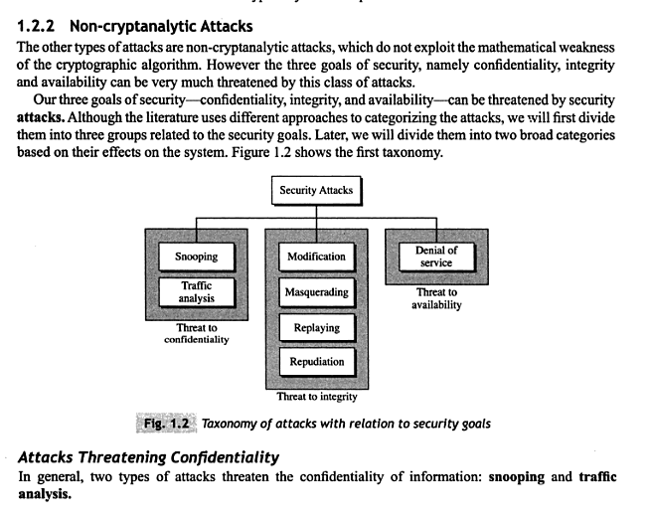
Non Cryptanalytic Attacks

Slide 26
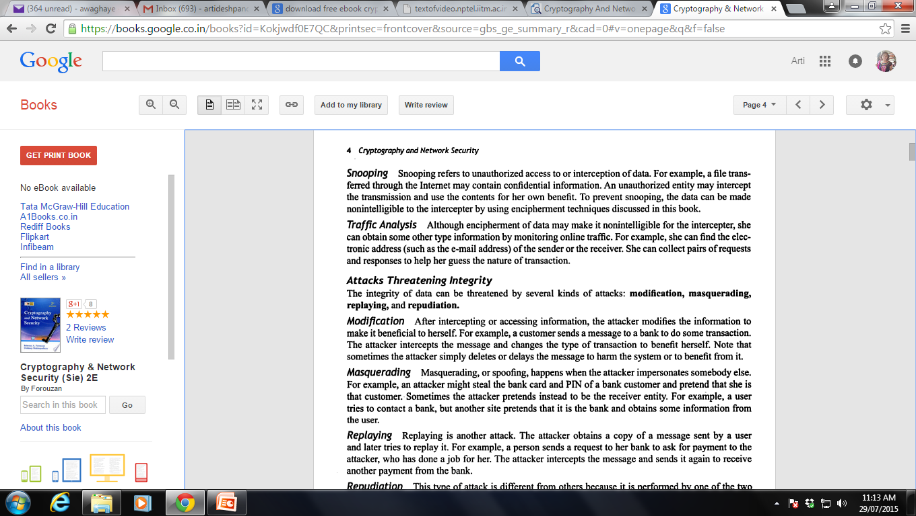

Slide 27
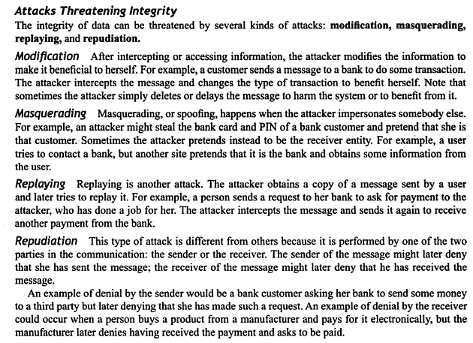

Slide 28
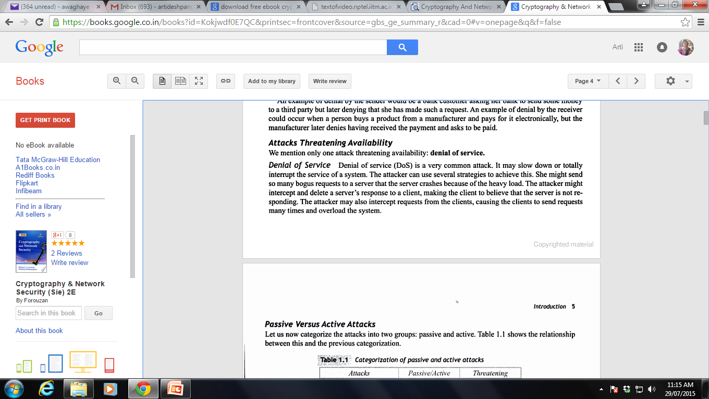

Slide 29
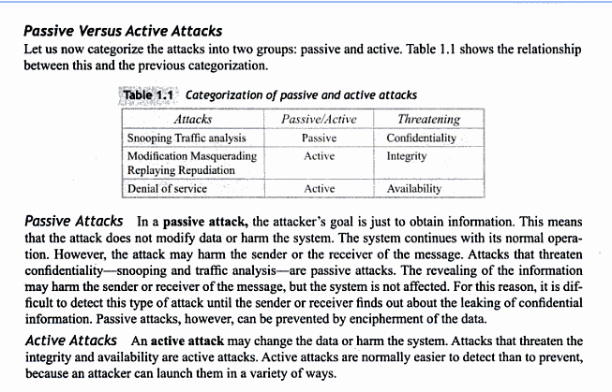

Slide 30
Security Service
  enhance security of data processing systems and information transfers of an organization
  intended to counter security attacks
  using one or more security mechanisms
  often replicates functions normally associated with physical documents
    which, for example, have signatures, dates; need protection from disclosure, tampering, or destruction; be notarized or witnessed; be recorded or licensed
Notes:
Consider the role of a security service, and what may be required.
Note both similarities and differences with traditional paper documents, which for example:
have signatures & dates;
need protection from disclosure, tampering, or destruction;
may be notarized or witnessed;
may be recorded or licensed

Slide 31
Security Services
X.800:
  “a service provided by a protocol layer of communicating open systems, which ensures adequate security of the systems or of data transfers”
RFC 2828:
  “a processing or communication service provided by a system to give a specific kind of protection to system resources”
Notes:
State here a couple of definitions of “security services” from relevant standards. X.800 defines a security service as a service provided by a protocol layer of communicating open systems, which ensures adequate security of the systems or of data transfers. Perhaps a clearer definition is found in RFC 2828, which provides the following definition: a processing or communication service that is provided by a system to give a specific kind of protection to system resources; security services implement security policies and are implemented by security mechanisms.

Slide 32
Security Services (X.800)
Authentication - assurance that communicating entity is the one claimed
  have both peer-entity & data origin authentication
Access Control - prevention of the unauthorized use of a resource
Data Confidentiality –protection of data from unauthorized disclosure
Data Integrity - assurance that data received is as sent by an authorized entity
Non-Repudiation - protection against denial by one of the parties in a communication
Availability – resource accessible/usable
Notes:
This list is taken from Stallings Table 1.2 which provides details of the 5 Security Service categories and the 14 specific services given in X.800.
This list includes the various "classic" security services which are traditionally discussed. Note there is a degree of ambiguity as to the meaning of these terms, and overlap in their use. The broad service categories are:
authentication is concerned with assuring that a communication is authentic. Two specific authentication services are defined in X.800: Peer entity authentication: provides corroboration of the identity of a peer entity in an association; and Data origin authentication: provides corroboration of the source of a data unit.
access control is the ability to limit and control the access to host systems and applications via communications links.
confidentiality is the protection of transmitted data from passive attacks, and the protection of traffic flow from analysis.
integrity assures that messages are received as sent, with no duplication, insertion, modification, reordering, replay, or loss.
availability is the property of a system / resource being accessible and usable upon demand by an authorized system entity, according to performance specifications for the system.

Slide 33
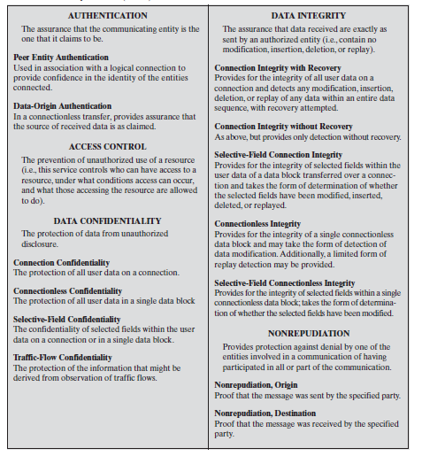

Slide 34
Security Mechanism
feature designed to detect, prevent, or recover from a security attack
no single mechanism that will support all services required
however one particular element underlies many of the security mechanisms in use:
  cryptographic techniques
Notes:
Now introduce “Security Mechanism” which are the specific means of implementing one or more security services. Note these mechanisms span a wide range of technical components, but one aspect seen in many is the use of cryptographic techniques.

Slide 35
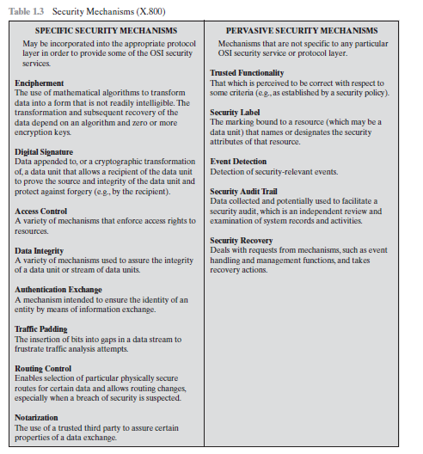

Slide 36
Security Mechanisms (X.800)
specific security mechanisms:
  encipherment, digital signatures, access controls, data integrity, authentication exchange, traffic padding, routing control, notarization
  May be incorporated into the appropriate protocol layer in order to provide some of the OSI security services.
pervasive security mechanisms:
  trusted functionality, security labels, event detection, security audit trails, security recovery
Notes:
Some examples of mechanisms from X.800. Note that the “specific security mechanisms” are protocol layer specific, whilst the “pervasive security mechanisms” are not. We will meet some of these mechanisms in much greater detail later.
See Stallings Table 1.3 for details of these mechanisms in X.800, and Table 1.4 for the relationship between services and mechanisms.

Slide 37
SPECIFIC SECURITY MECHANISMS ARE :
1. Encipherment
The use of mathematical algorithms to transform
data into a form that is not readily intelligible .The
transformation and subsequent recovery of the
data depend on an algorithm and zero or more
encryption keys
2. Digital Signature
Data appended to, or a cryptographic transformation
of, a data unit that allows a recipient of the data unit
to prove the source and integrity of the data unit and
protect against forgery (e.g., by the recipient).
3. Access Control
A variety of mechanisms that enforce access rights to
resources.

Slide 38
4. Data Integrity
A variety of mechanisms used to assure the integrity
of a data unit or stream of data units.
5. Authentication Exchange
A mechanism intended to ensure the identity of an
entity by means of information exchange.
6. Traffic Padding
The insertion of bits into gaps in a data stream to
frustrate traffic analysis attempts.

Slide 39
7. Routing Control
Enables selection of particular physically secure
routes for certain data and allows routing changes,
especially when a breach of security is suspected.
8. Notarization
The use of a trusted third party to assure certain
properties of a data exchange.

Slide 40
PERVASIVE SECURITY MECHANISMS
Mechanisms that are not specific to any particular
OSI security service or protocol layer.
1. Trusted Functionality
That which is perceived to be correct with respect to
some criteria (e.g., as established by a security policy).
2. Security Label
The marking bound to a resource (which may be a
data unit) that names or designates the security
attributes of that resource.

Slide 41
4. Event Detection
Detection of security-relevant events.
5. Security Audit Trail
Data collected and potentially used to facilitate a
security audit, which is an independent review and
examination of system records and activities.
6. Security Recovery
Deals with requests from mechanisms, such as event
handling and management functions, and takes
recovery actions.

Slide 42
